Slide 1
Introduction to errors
Konstantin Volzhenin
Sorbonne university, Paris, France

Slide 2
Presentation outline
Introduction
Errors in terms of scientific experiment
Errors in statistics
Covariance and correlation
Error propagation
Q&A

Slide 3
Decoding the nature of errors
What are errors?
Errors represent discrepancies between measured/estimated/predicted and true values.
In mathematical terms ERROR IS NOT A “MISTAKE”!
Errors are rather a quantitative measure of “how far” we are to the ground truth.

Slide 4
Why Does Error Analysis Matter?
Preserving Scientific Integrity:
Errors can compromise the integrity of scientific findings.
Rigorous error analysis ensures the reliability of research outcomes.
Data Accuracy and Reproducibility:
Reliable data is fundamental for accurate replication of experiments.
Minimizing errors enhances the reproducibility of scientific studies.
Informed Decision-Making:
Researchers and policymakers rely on accurate data for decision-making.
Accurate error calculation allows to estimate the boundaries of applicability of a certain research.
Continuous Improvement in Methodologies:
Identifying errors prompts refinement of experimental methodologies.

Slide 5
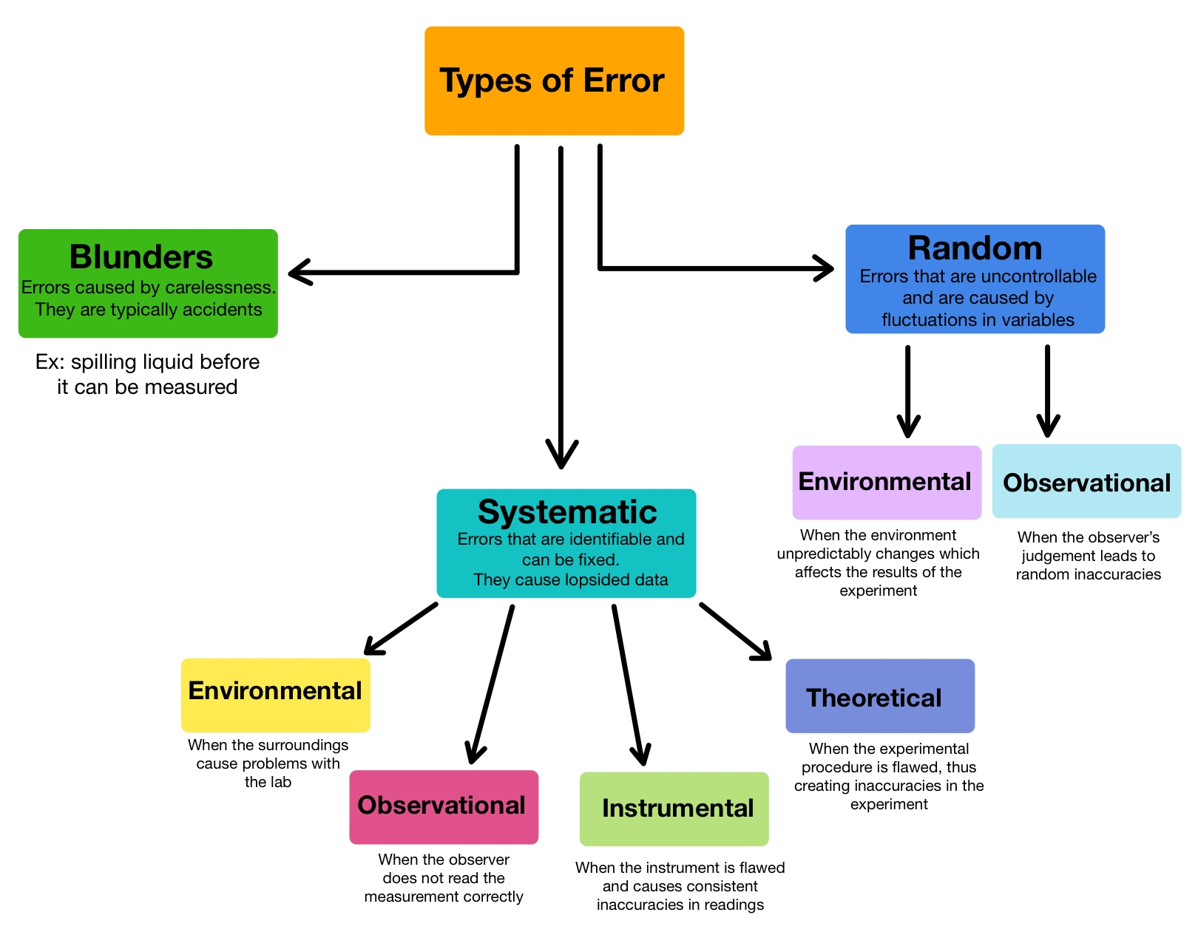
Types of Errors in Scientific Research

Slide 6
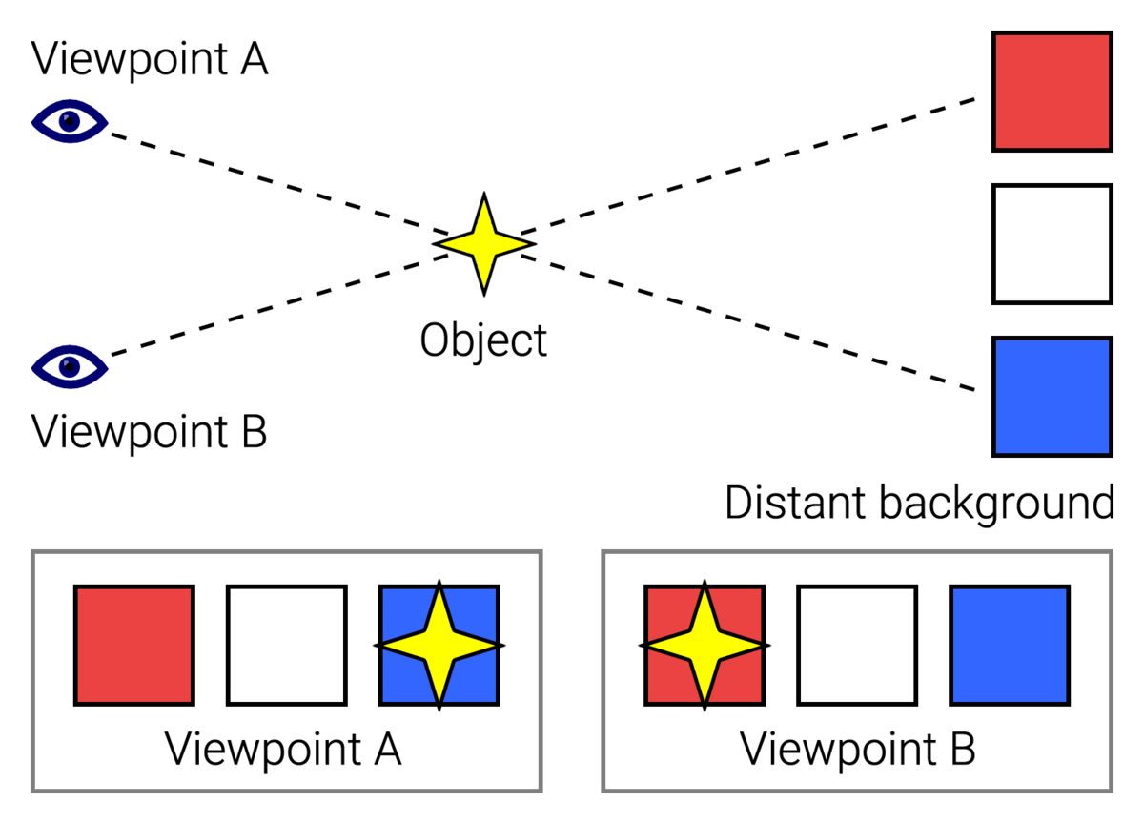
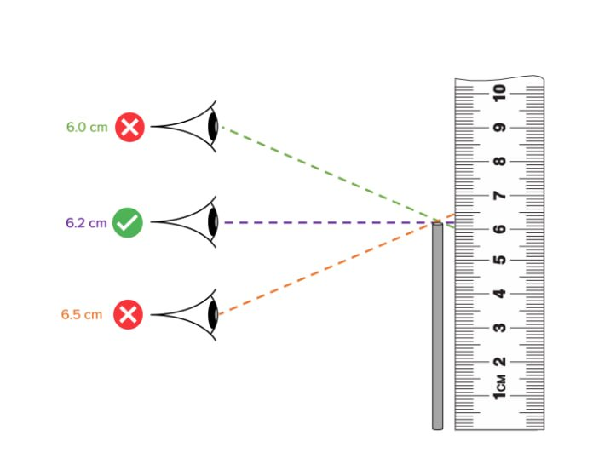
Systematic errors
Instrumental:
Causes: Inaccuracies in measurement instruments
Examples: Calibration issues
Observational:
Causes: Limitations in the observer's perception or interpretation.
Examples: Parallax error
Environmental:
Causes: Systematic changes in environmental conditions
Examples: Radioactive background
Theoretical:
Causes: Inaccuracies or simplifications in the theoretical framework.
Examples: Assumptions that deviate from real-world conditions, model limitations.

Slide 7
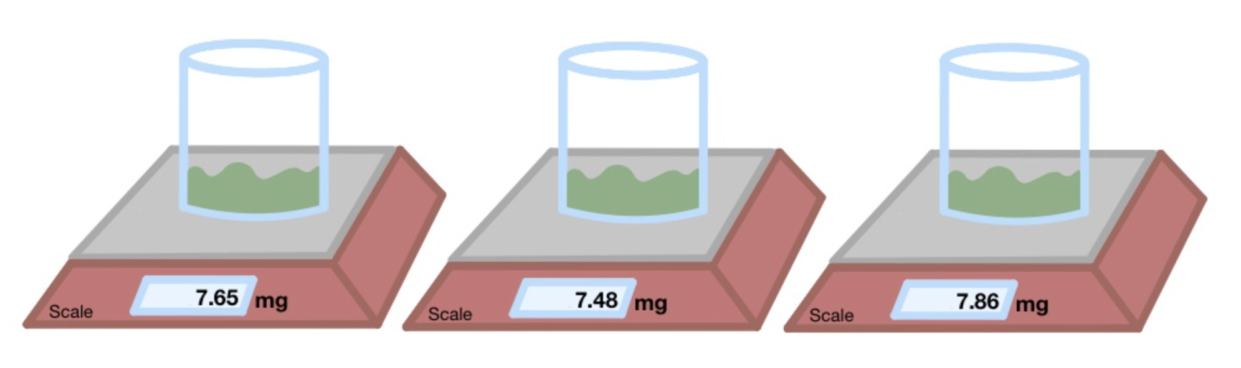
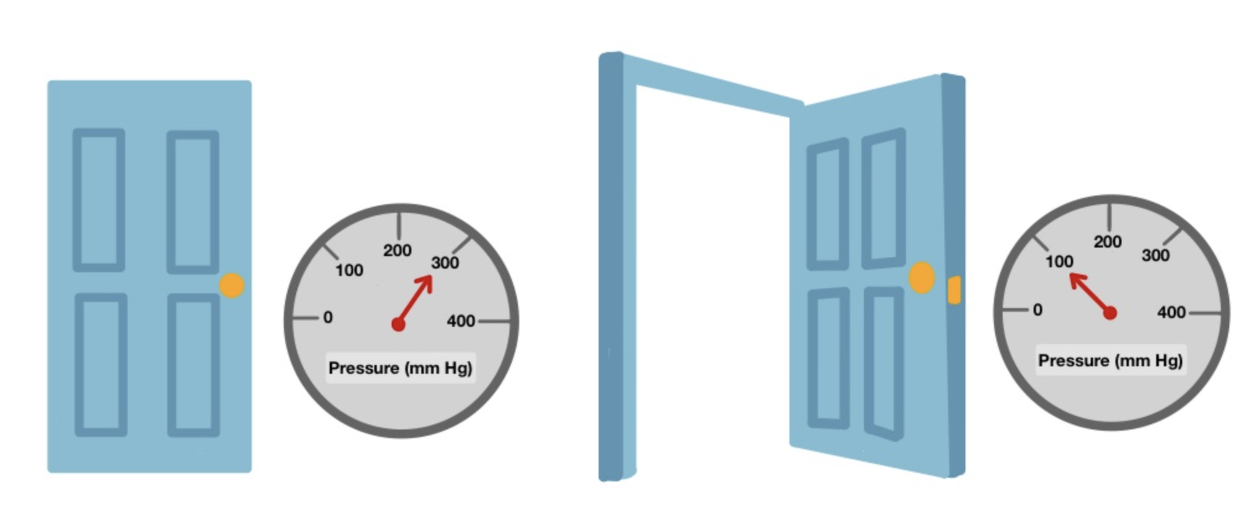
Random errors
Observational:
Causes: Limitations in the observer's perception or interpretation
Examples: Variations in human observation
Environmental:
Causes: Fluctuations in environmental conditions during measurements
Examples: Temperature/pressure fluctuations, humidity effects impacting instrument readings

Slide 8
Question: You manually take measurements for an experiment along with your colleague. After 2 hours you both went on a break and were replaced by other lab workers. Can this introduce new errors in your measurements? If yes, what type: systematic or random?

Slide 9
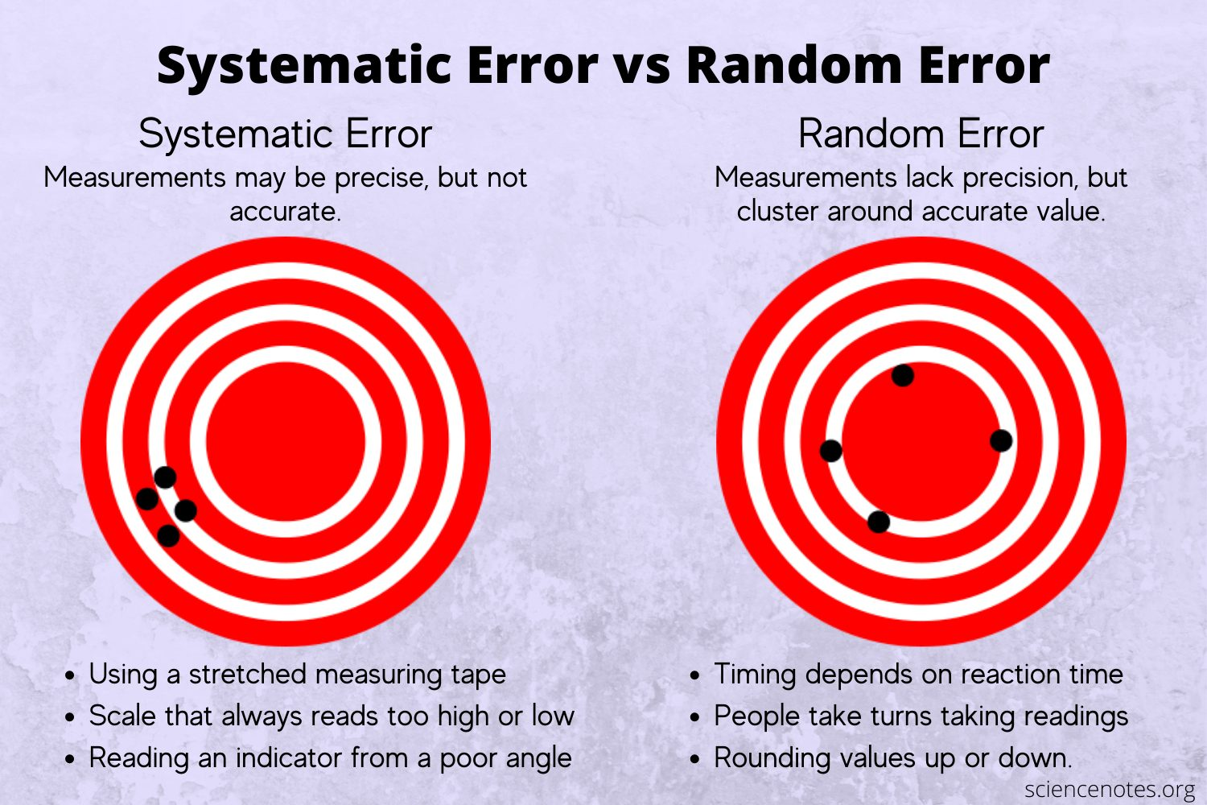
Random vs systematic errors

Slide 10
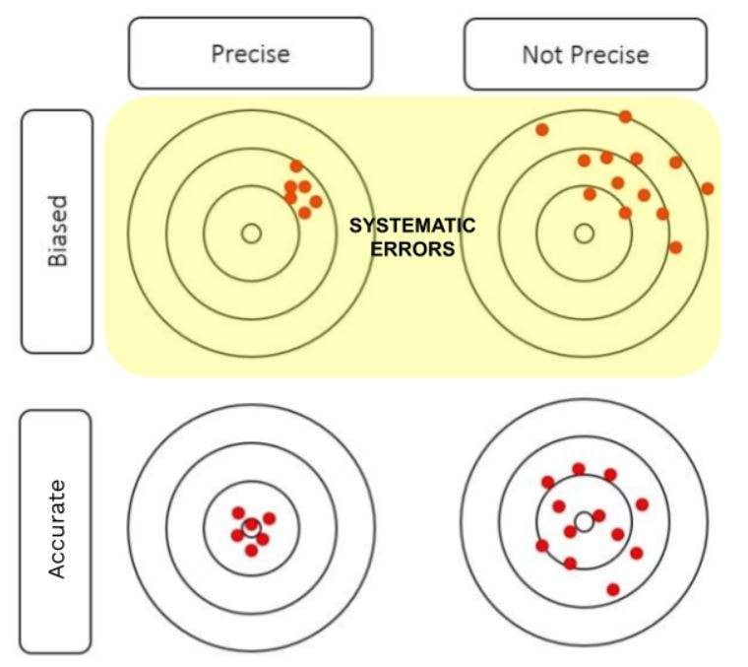
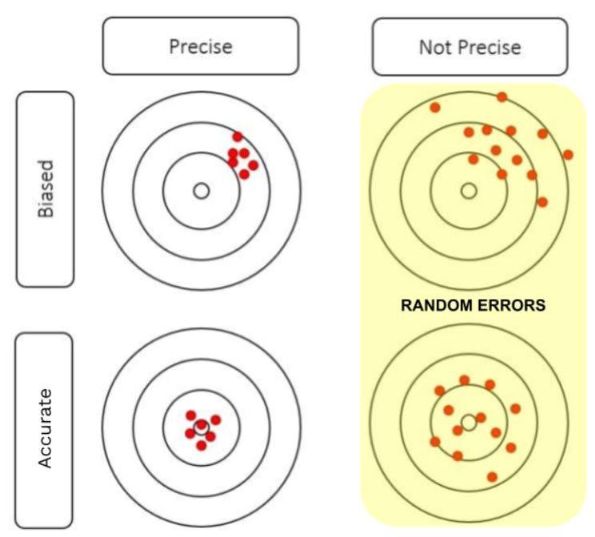
Random vs systematic errors

Slide 11
How to Minimize systematic errors?
A. Conduct more experiments
B. Take an average
C. Change equipment/method
D. Systematic errors can’t be minimized

Slide 12
How to Minimize random errors?
A. Conduct more experiments
B. Try to transform the random errors into systematic
C. Change equipment/method
D. Random errors can’t be minimized

Slide 13
Errors in statistics
In statistics and optimization, errors and residuals are two closely related measures of the deviation of an observed value of an element of a statistical sample from its "true value" (not necessarily observable).
The error of an observation - the deviation of the observed value from the true value of a quantity of interest (for example, a population mean).
The residual - the difference between the observed value and the estimated value of the quantity of interest (for example, a sample mean).

Slide 14

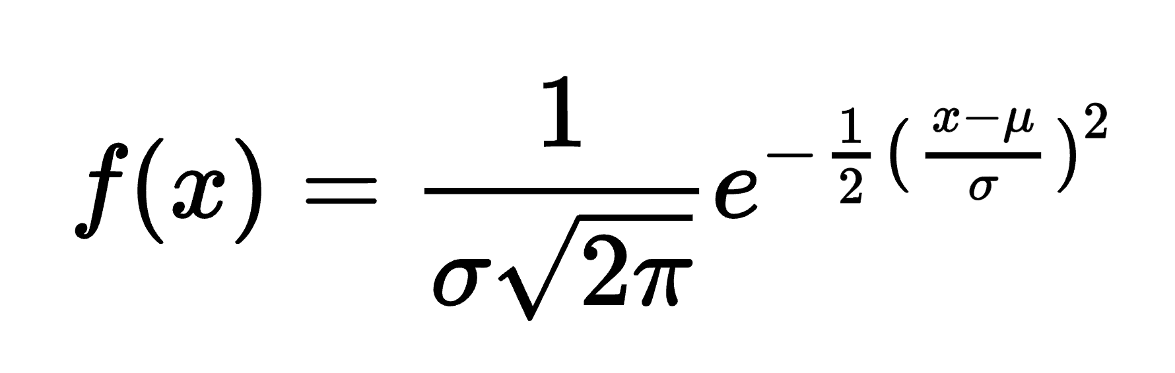
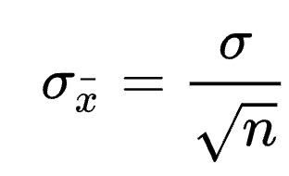
Standard error
The standard error of a statistic is the standard deviation of its or an estimate of that standard deviation.
Standard error of the mean (SEM):

Slide 15
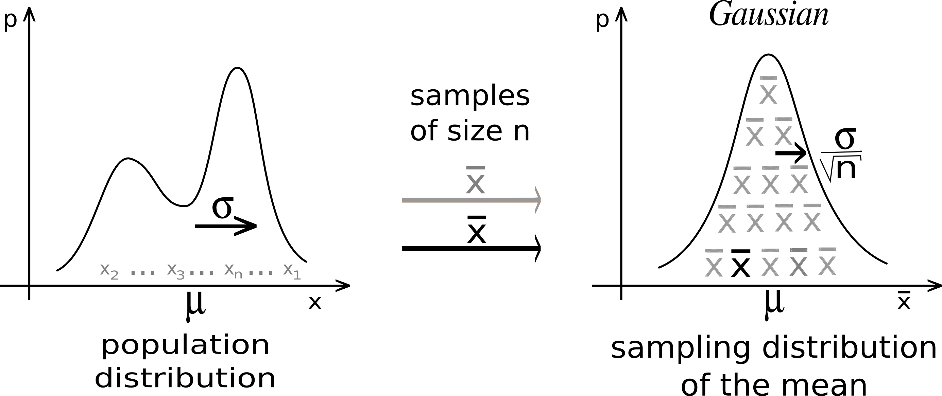
How to Minimize random errors: Central limit theorem (CLT)

Slide 16
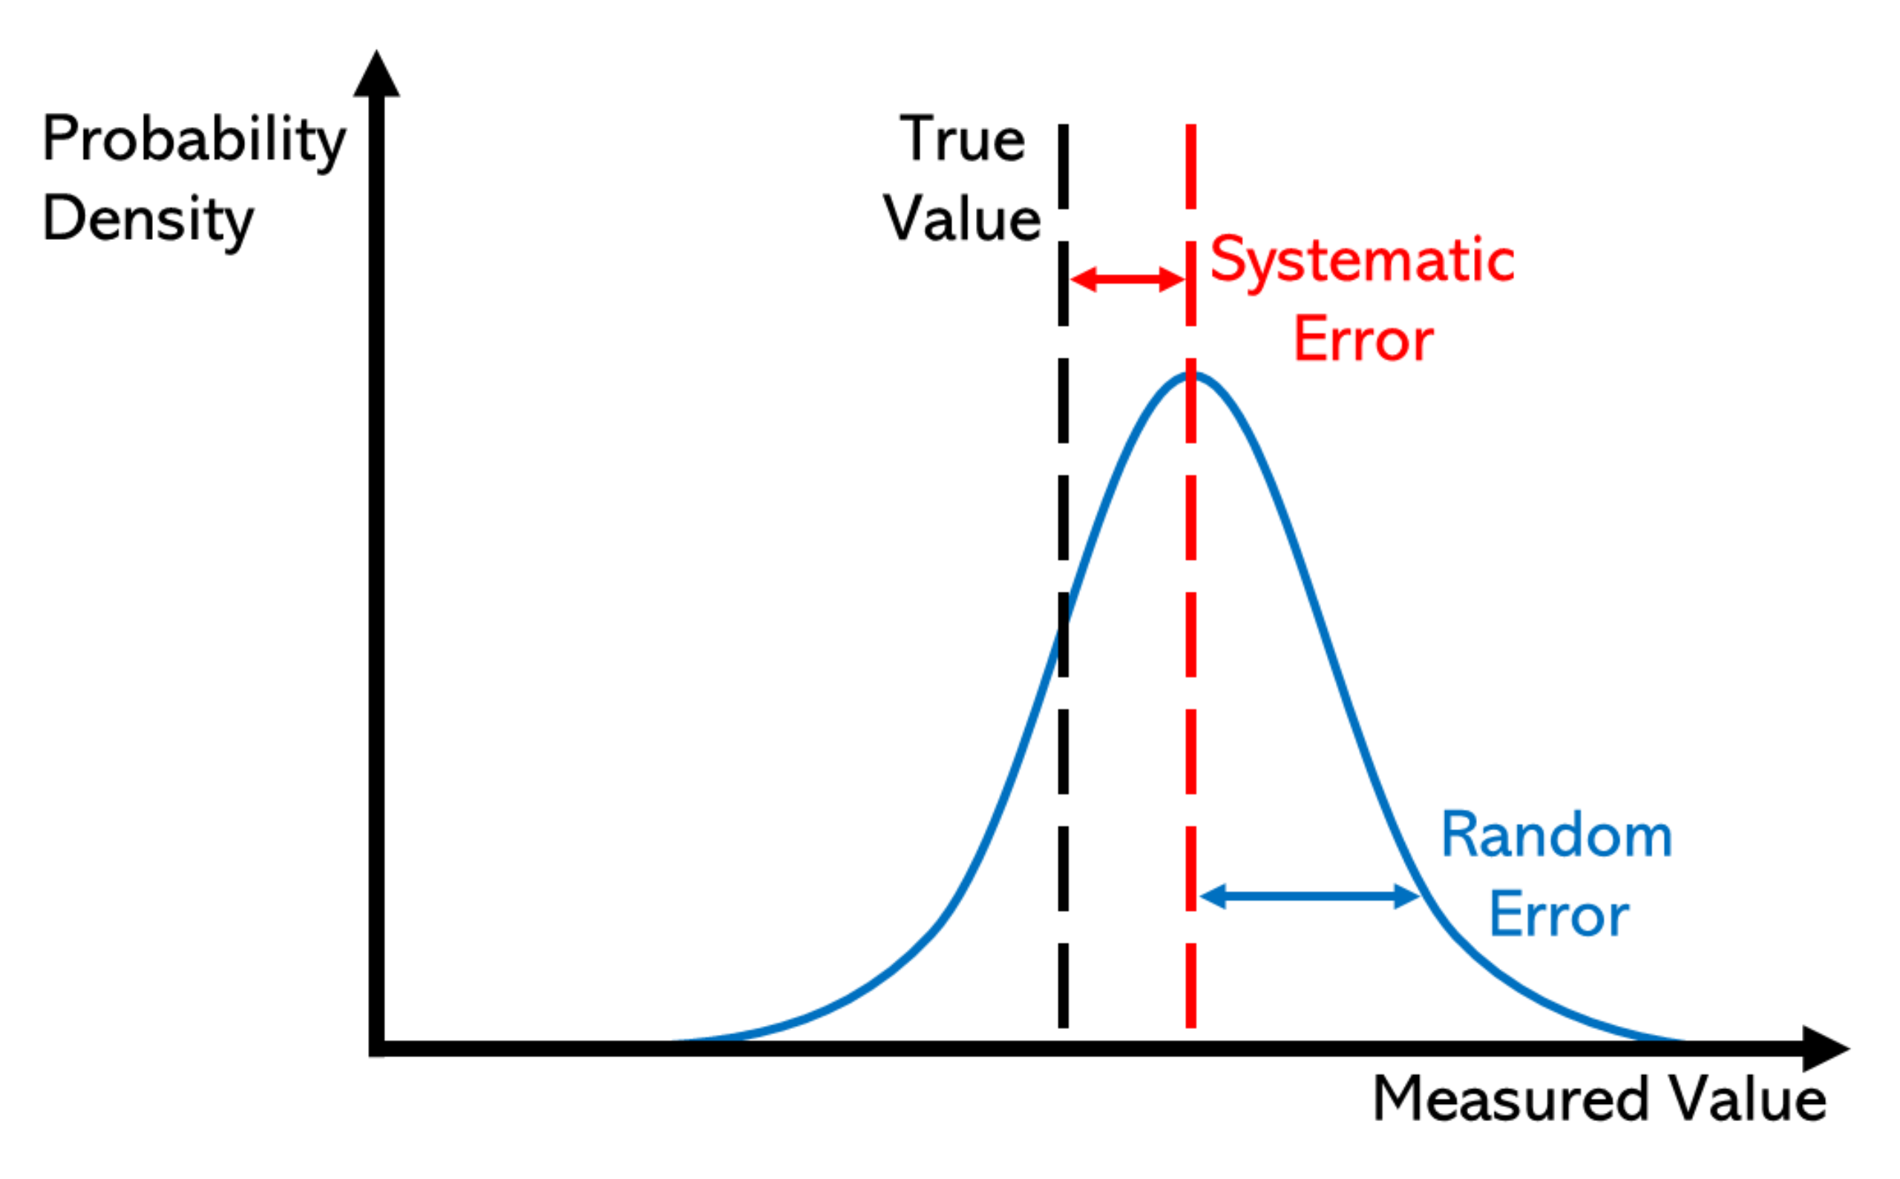

Slide 17
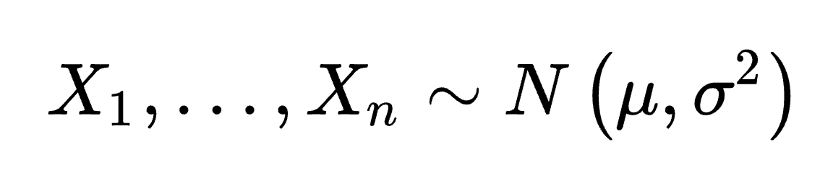
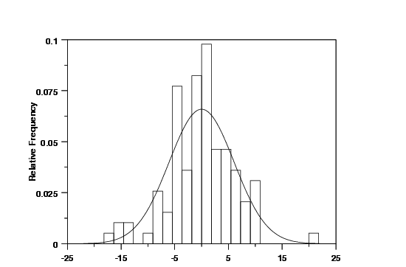
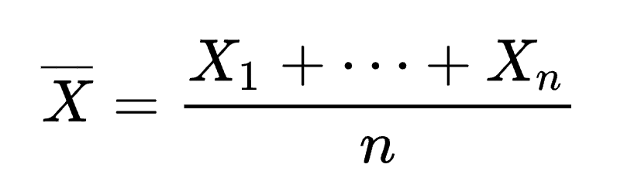
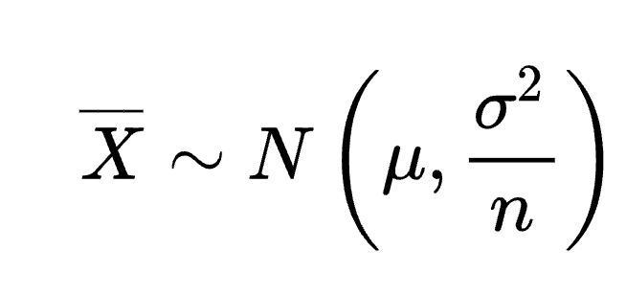
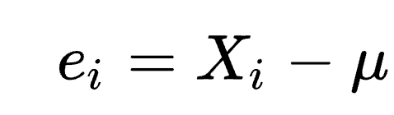
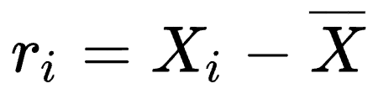
Statistical error vs residual
Given a normally distributed set of measures:
And the sample mean
The statistical error is computed as:
The residual is computed as:

Slide 18
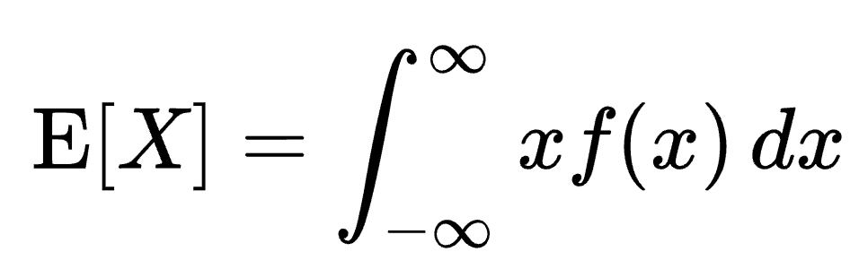
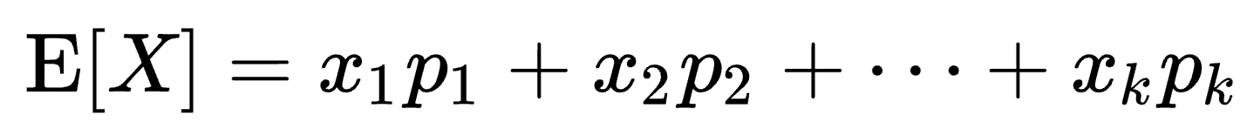
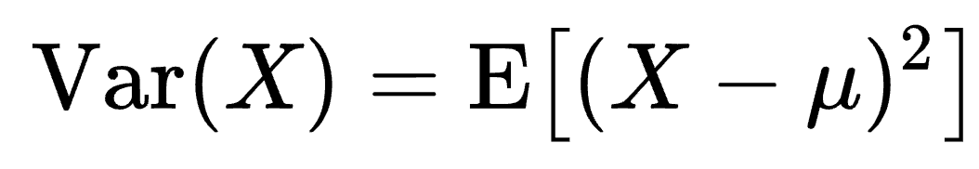
Covariance and correlation
Expected value E[X] - “generalized version” of the arithmetic mean for set of X.
Examples:
Random variables with density
Finite number of outcomes
The variance of a random variable X is the expected value of the squared deviation from the mean of X (μ = E[X]) :

Slide 19
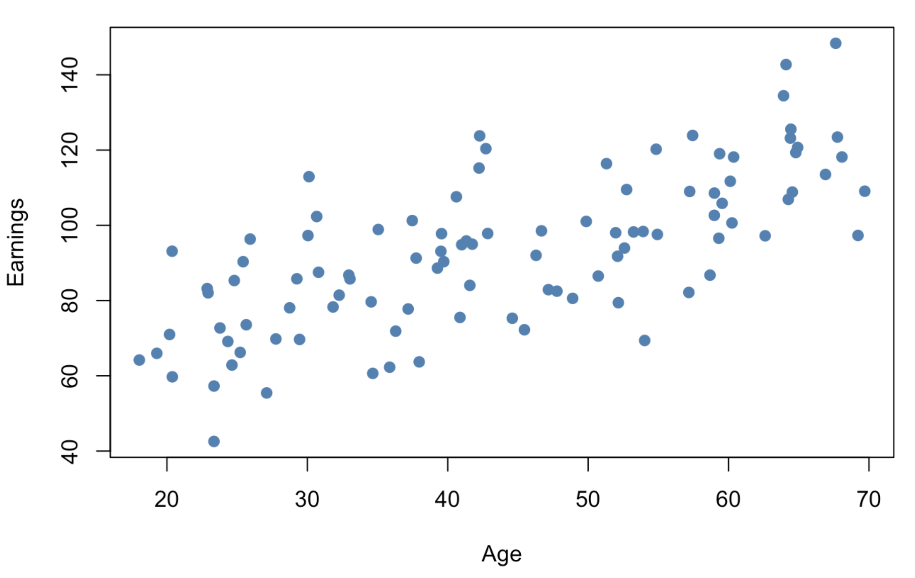
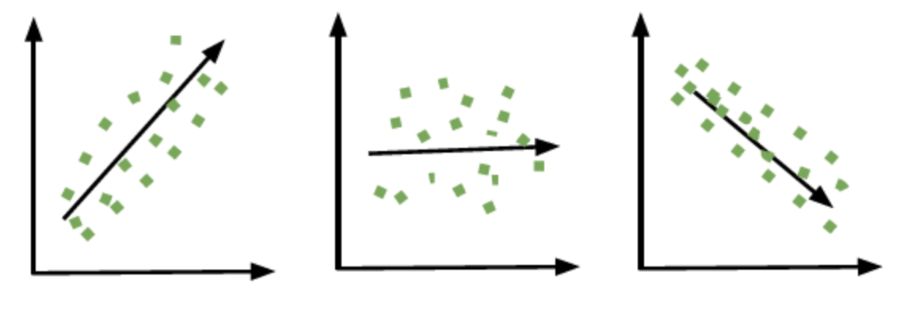
Covariance and correlation
Example:
X - Age of a person
Y - Earnings per year
Main question: Can paired measurement provide more information than simple individual measurements?
Three types of relationships:

Slide 20
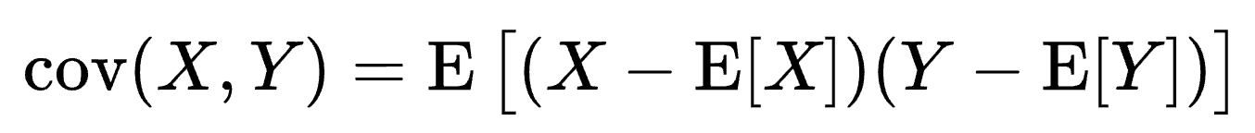
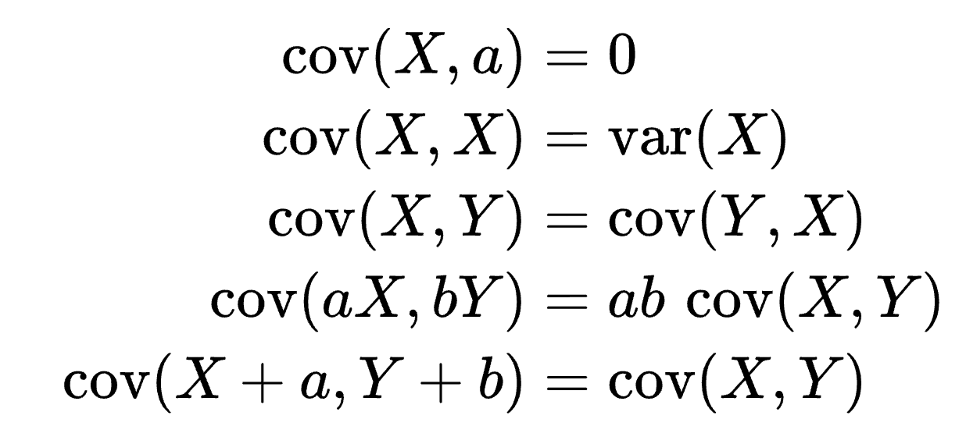
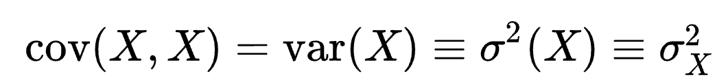
Covariance and correlation
Let there be two two jointly distributed real-valued random variables X and Y.
Covariance - the expected value of the product of deviations of X and Y from their individual expected values
Linear properties:
Covariance with itself = variance:

Slide 21
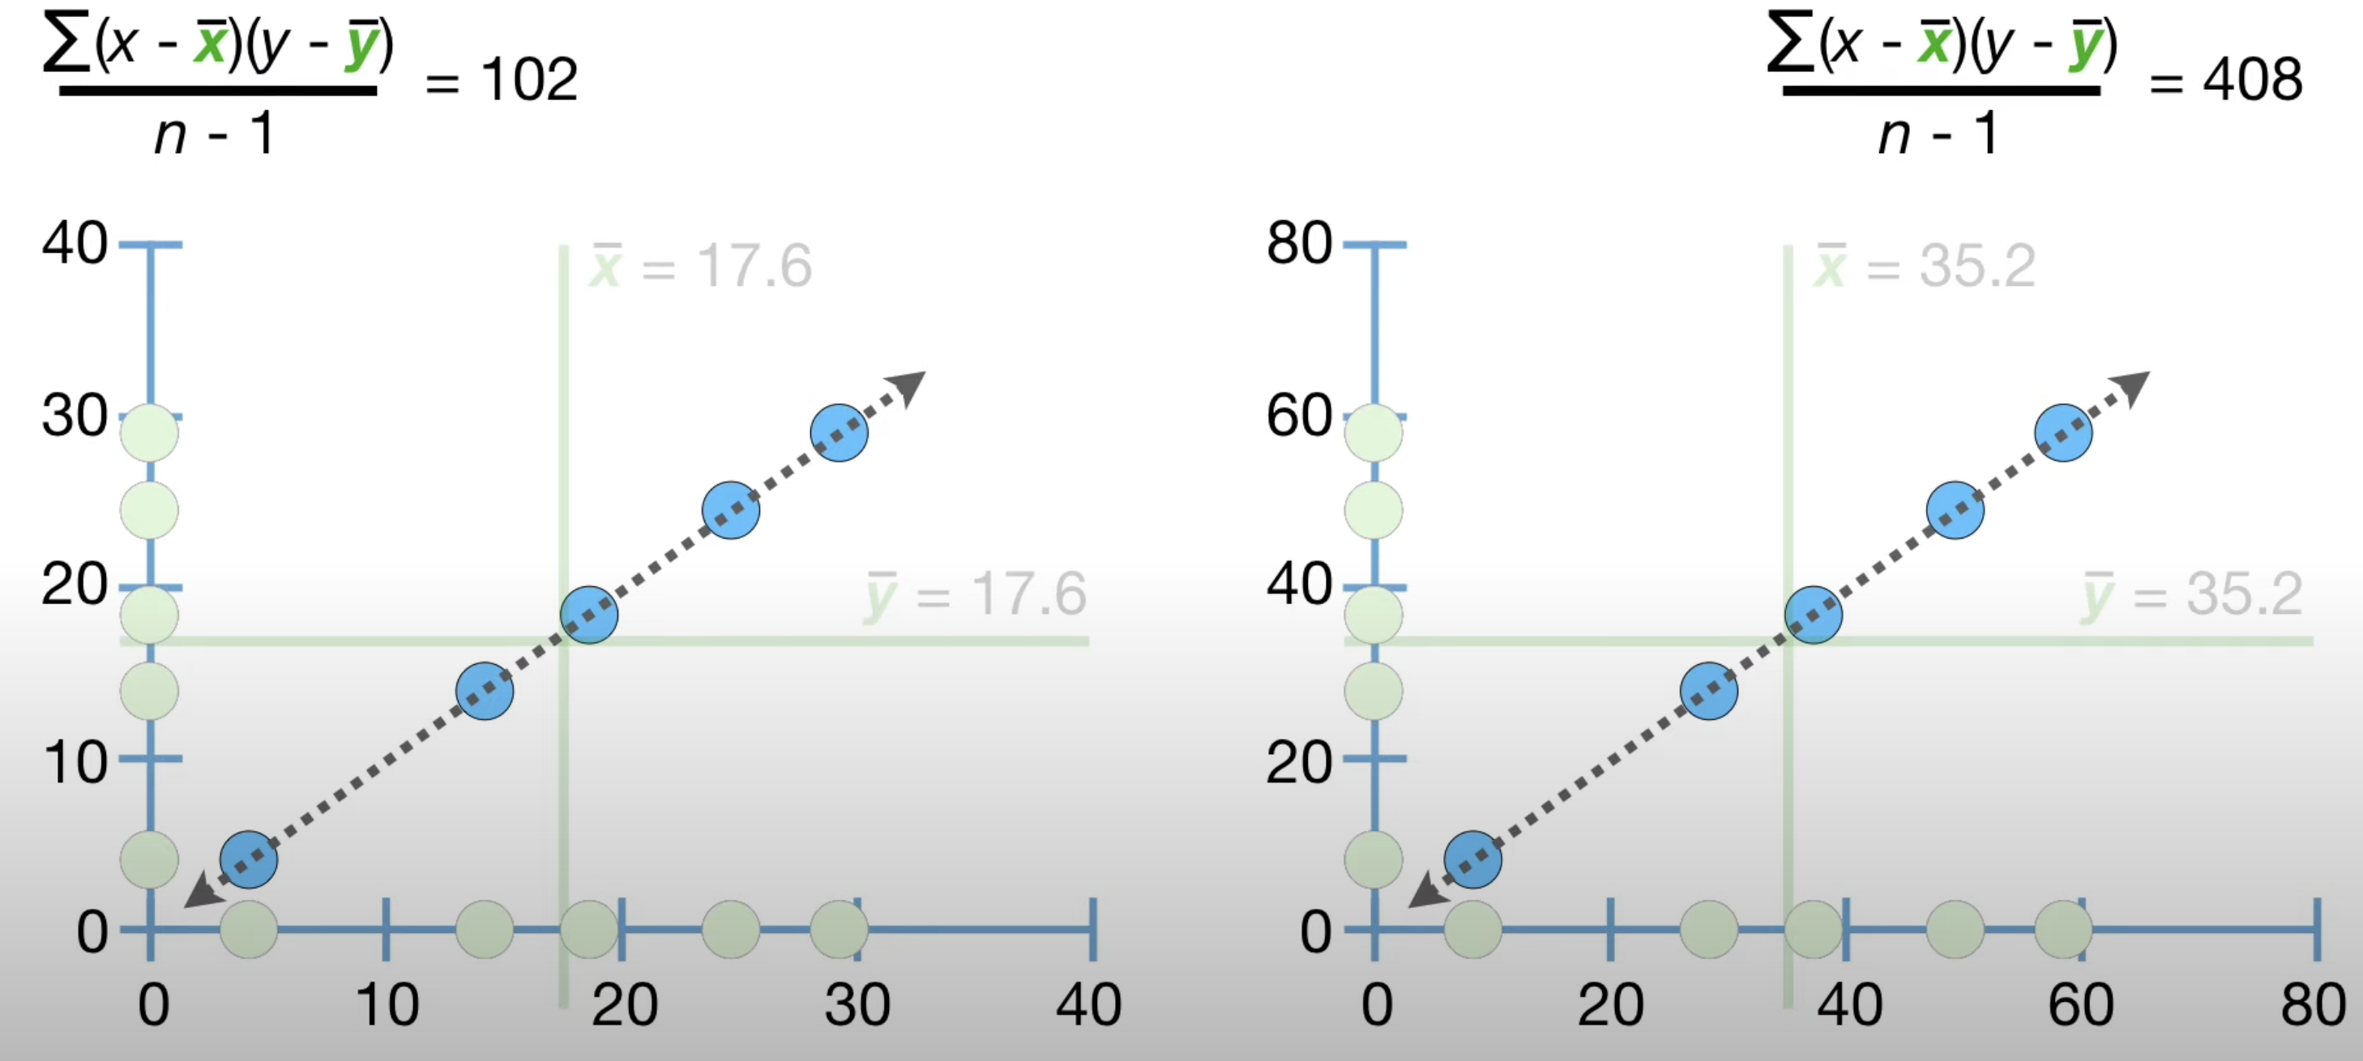
Covariance and correlation
Disadvantages of using covariance:

Slide 22
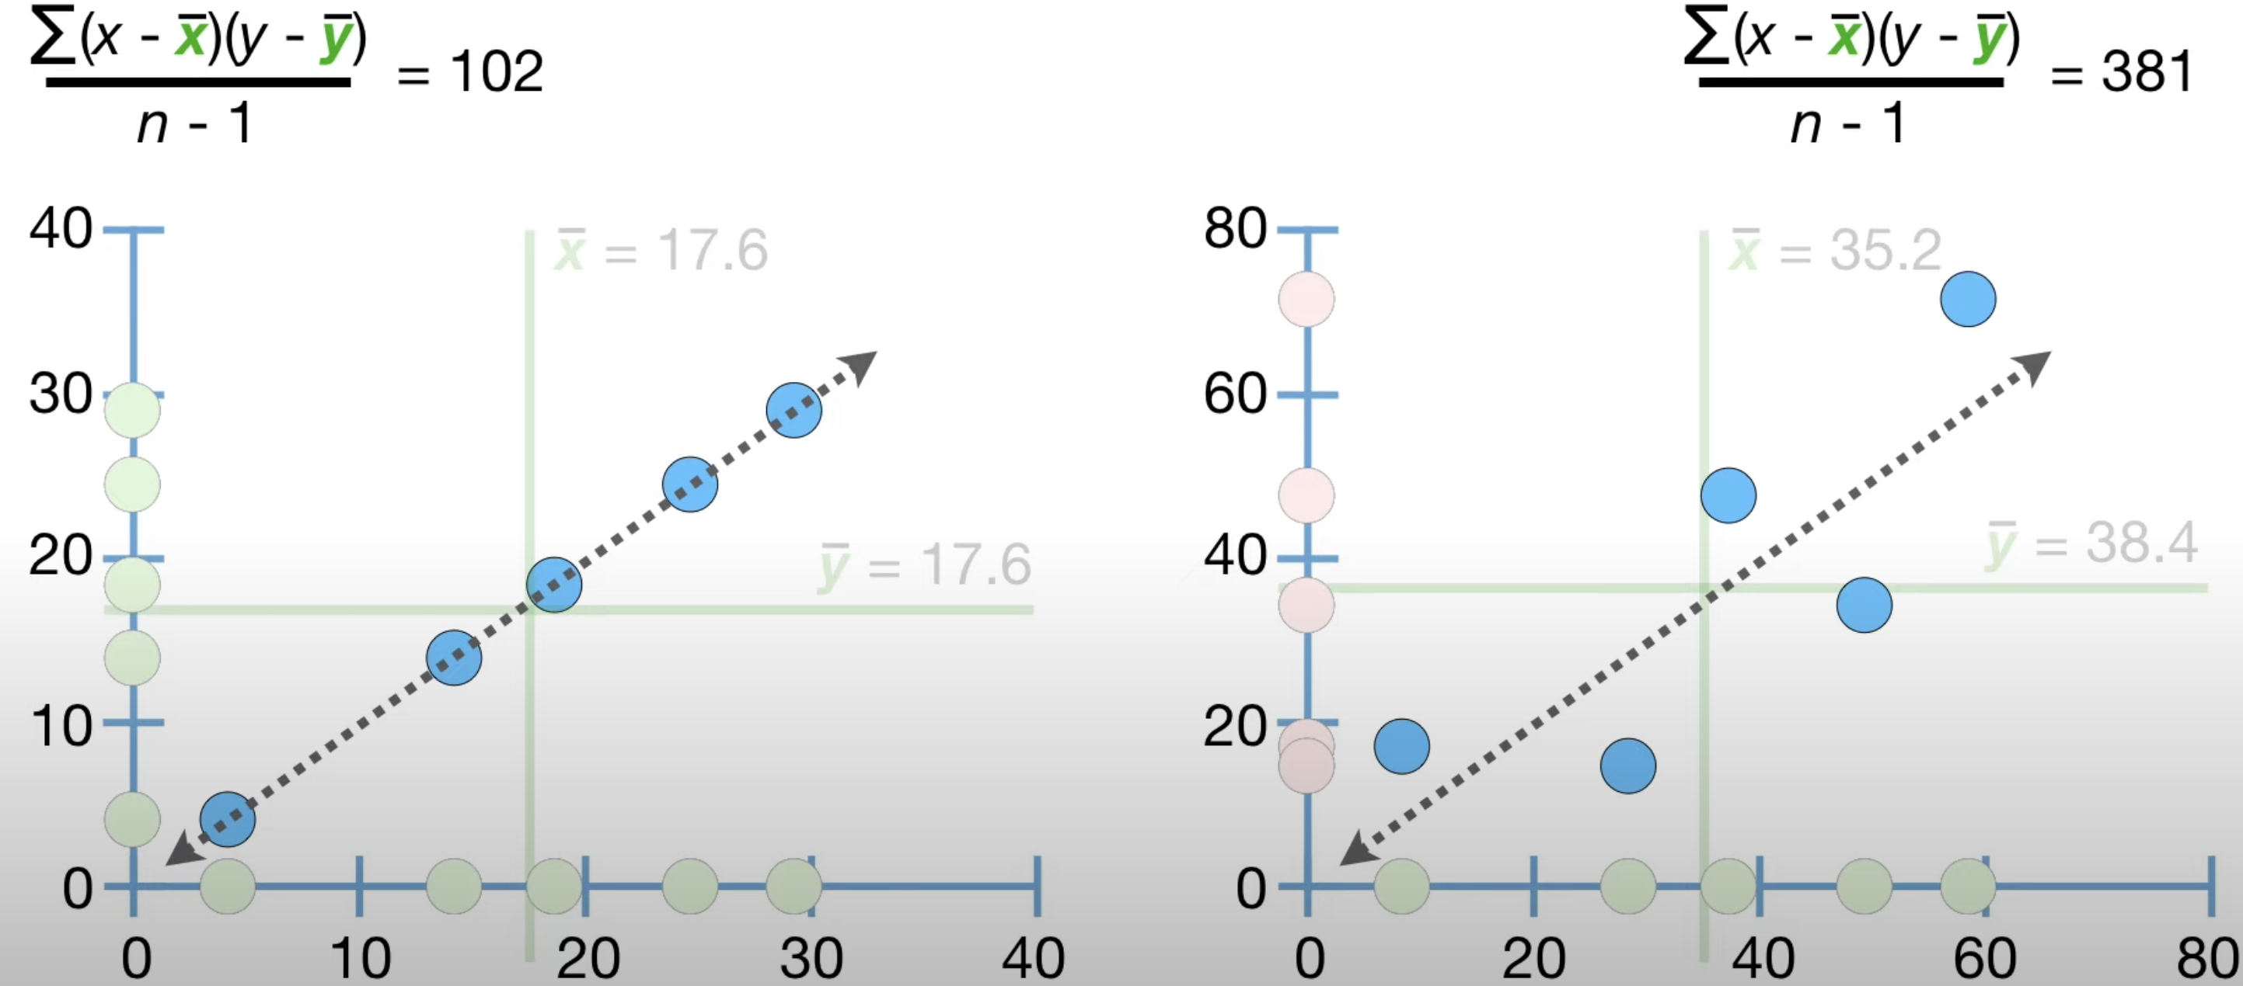
Covariance and correlation
Disadvantages of using covariance:

Slide 23
Covariance and correlation
Example:
X - Age of a person
Y - Earnings per year
Different question: What can X tell us about Y?

Slide 24
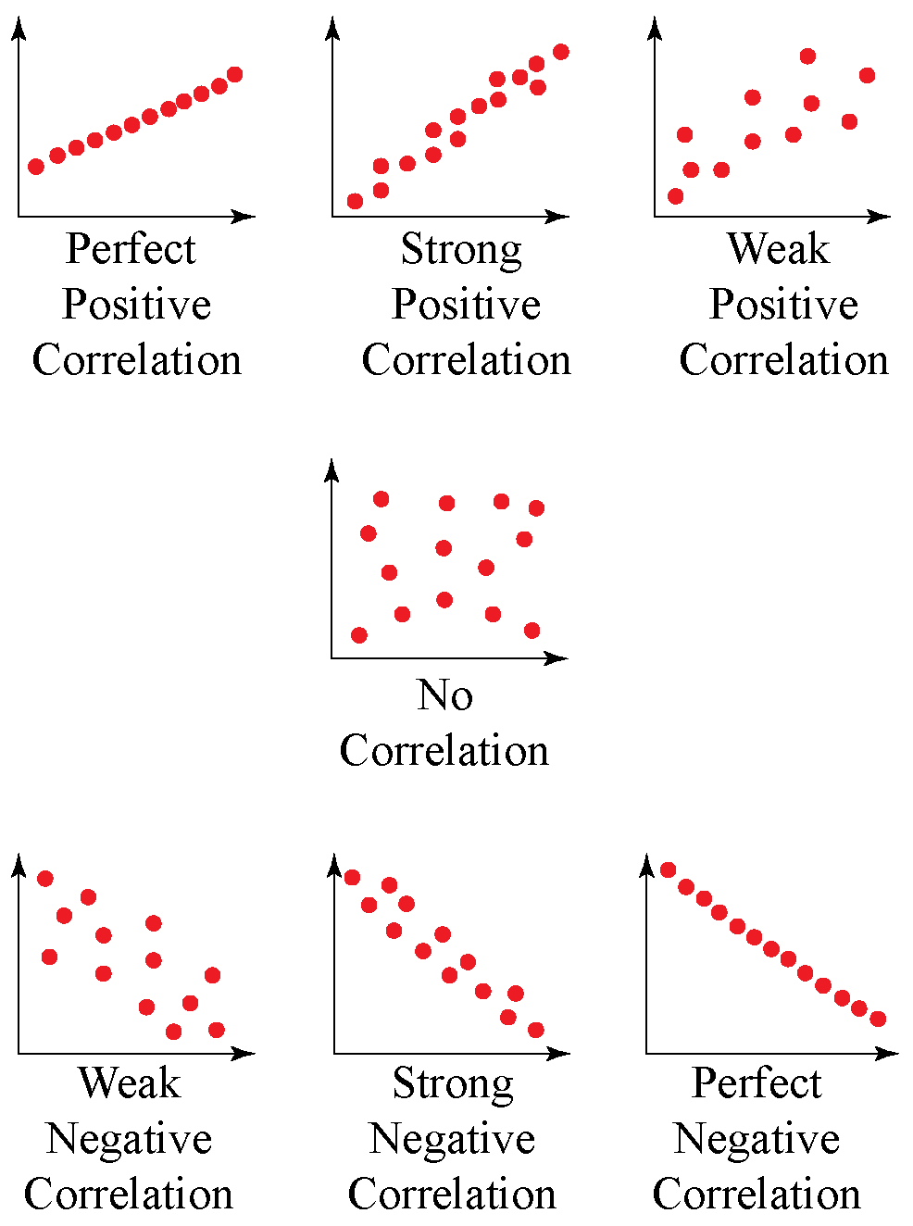
Covariance and correlation
Correlation quantifies relationships

Slide 25
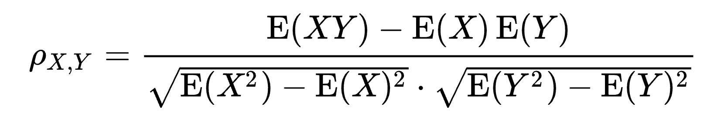
Covariance and correlation
The correlation coefficient can be computed in the following way:

Slide 26
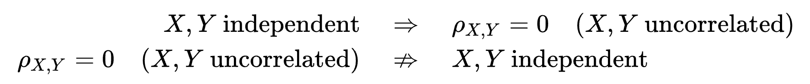
Covariance and correlation
Correlation for independent variables:
Correlation and causation:
CORRELATION DOES NOT IMPLY CAUSATION

Slide 27
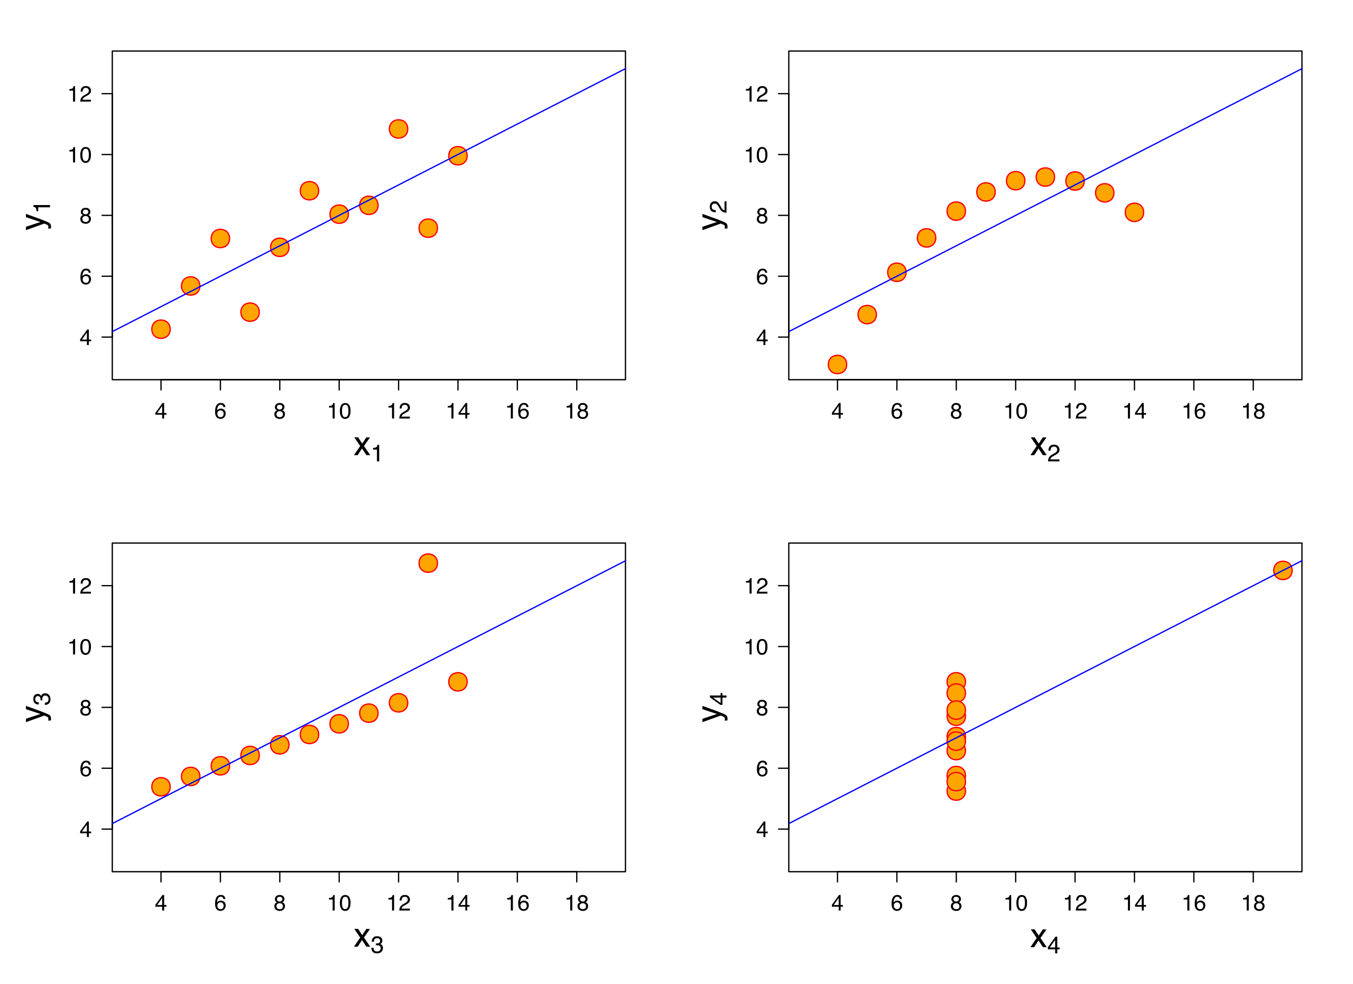
Covariance and correlation
Correlation does not tell us about the form of bivariate data
Anscombe's quartet:
four sets of data with the same correlation of 0.816

Slide 28
propagation of error
How to define uncertainty in an experiment?
absolute error Δx
relative error (Δx)/x (usually written as a percentage)
standard deviation, σ (positive square root of the variance)
The value of a quantity and its error are then expressed as an interval x ± u.

Slide 29
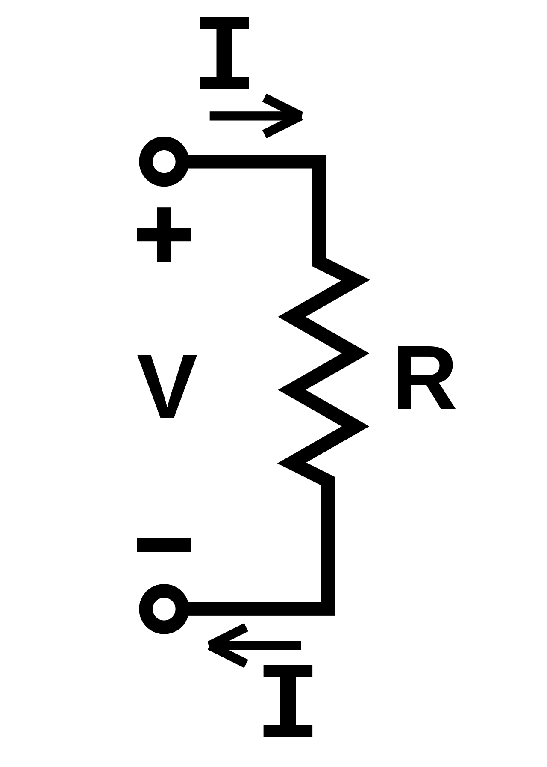
propagation of error
Example:
We would like to find the Voltage V in our circuit.
We measured the current I and the resistance R.
I = 0.3A ± 0.01A
R = 700Ω ± 15Ω
V = IR = 0.3A * 700Ω = 210V
But what about the error of V?

Slide 30
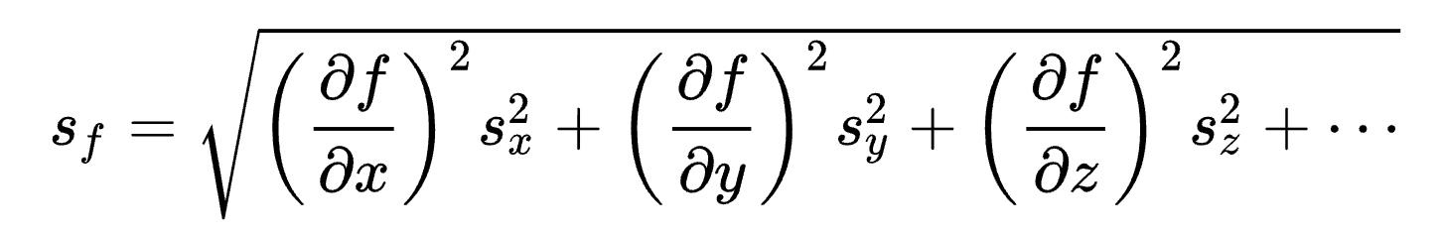
propagation of error
Let’s assume our variables are independent (correlation is zero).
In this case, the simplified formula for standard deviation due to error propagation:
This simplification is based on linear approximation and the assumption that sx, sy, sz… are small

Slide 31
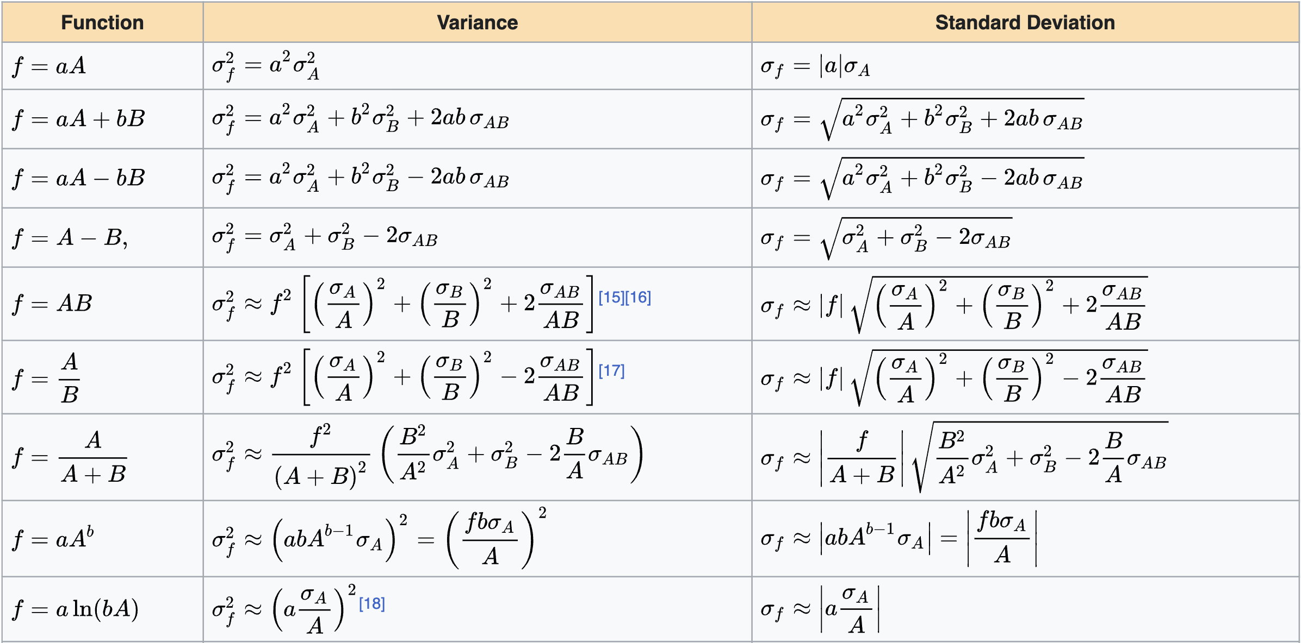
propagation of error

Slide 32
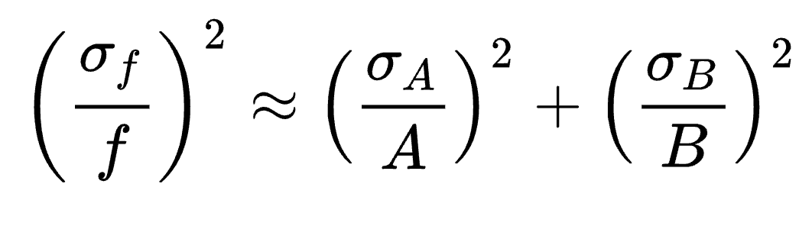
propagation of error
In the case of our example, f = AB, Corr(AB) = 0:
dV = 210V * sqrt((0.01/0.3)² + (15/700)²) = 8.32V
V = 210V ± 8V

